Slide 1
Computer Graphics
Chapter 2
  Input Devices

Slide 2
Input Devices
Logical Input Devices
  Categorized based on functional characteristics.
  Each device transmits a particular kind of data.
  The different types of data are called input primitives.
Physical Input Devices
  Categorized based on the physical machine.

Slide 3
Logical Input Devices
Locator Devices
  Input Primitive: Coordinate position (x,y)
  Examples: Mouse, Keyboard (Cursor-Position Keys), Tablet(Digitizer), Trackballs, Lightpens.
  Applications: Interactive drawing and editing, Graph digitizing.

Slide 4
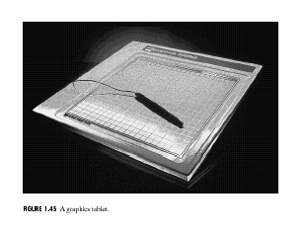
Digitizer

Slide 5
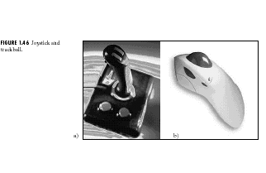
Joystick and Trackball

Slide 6
Logical Input Devices
String Devices
  Input Primitive: A string of characters
  Example: Keyboard
  Applications: Text input

Slide 7
Logical Input Devices
Valuator
  Input primitive: Scalar values (typically between 0 and 1).
  Examples: Control Dials, Sensing devices, Joysticks
  Applications: Input of graphics parameters, Graphics representation of analog values, Process simulation, Games.

Slide 8
Logical Input Devices
Choice
  Input primitive: A selection from a list of options.
  Examples: Mouse, Keyboard (Function Keys), Touch Panel etc
  Applications: Interactive menu selection, Program control.

Slide 9
Logical Input Devices
Pick
  Input primitive: Selection of a part of the screen.
  Examples: Mouse, Cursor Keys, Tablet.
  Applications: Interactive editing and positioning.

Slide 10
Physical Input Devices
Keyboard (input functions: String, Choice, Locator).
Mouse (input functions: Locator, Pick, Choice).
Joystick (input functions: Locator, Valuator).
Knob (Valuator).
Tablet (Locator, Pick).

Slide 11
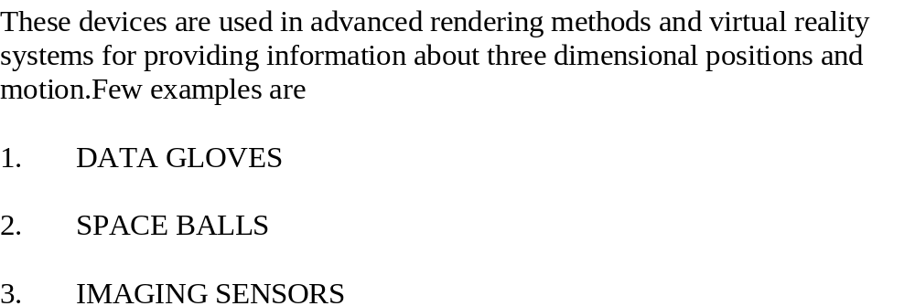
3D Interaction Devices (Recent additions)
These devices are used in advanced rendering methods and virtual reality systems for providing information about three dimensional positions and motion.Few examples are
1. DATA GLOVES
2 SPACE BALLS

Slide 12
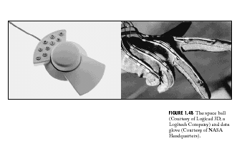
Space Ball, Data Glove

Slide 13
Event Driven Programming
• Mouse clicked.
• Mouse dragged.
• A key is pressed.
• The window is resized.
• The window is moved.
• Register.
• Define.
Call-back
Functions
Event
Event Queue

Slide 14
Mouse Interaction
Mouse Event
  Event that occurs when the mouse button is pressed or released.
Mouse Motion Event
  Event that occurs when the mouse is moved while one of the buttons is pressed.

Slide 15
Mouse Event
Contains the following information:
  Button: The mouse button that is pressed – left, middle, right.
  State: The state of the button – up, down.
  Position: The position of the mouse when the event occurs (x, y).

Slide 16
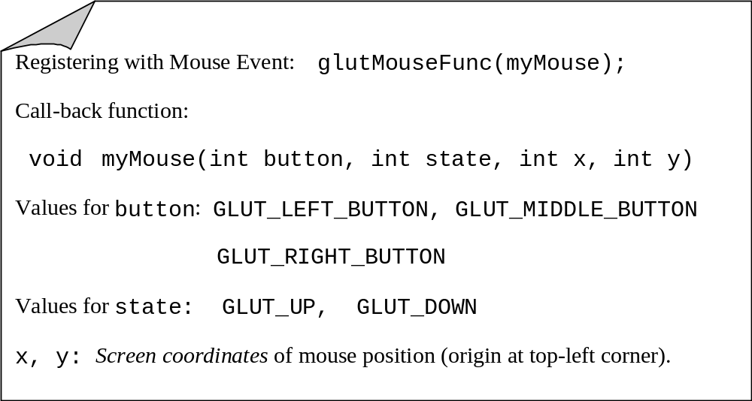
Mouse Event (OpenGL)

Slide 17
Mouse Motion Event
Contains the following information:
  Position: The current position of the mouse as the mouse is being dragged holding one of the buttons pressed. The events are continuously generated as the mouse button is pressed and dragged.

Slide 18
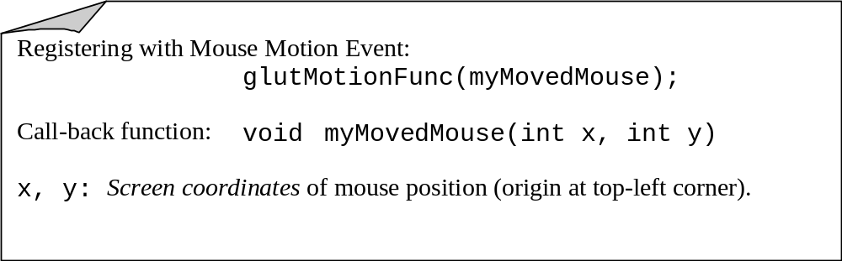
Mouse Motion Event (OpenGL)

Slide 19
Keyboard Event
Contains the following information:
  key: The ASCII value of the key pressed.
  Position: The current position of the mouse when the key is pressed.

Slide 20
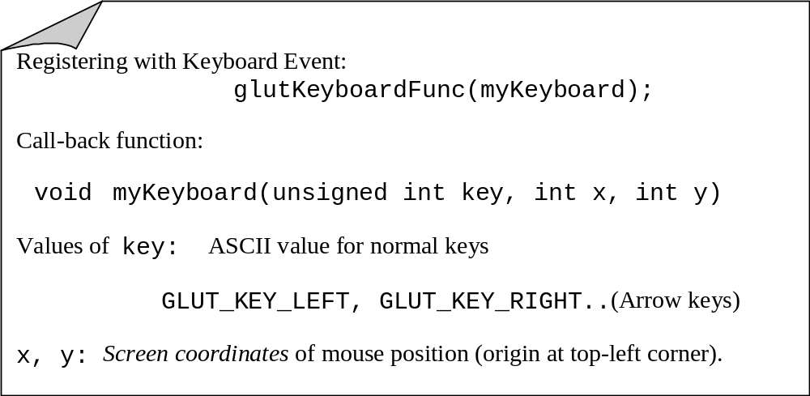
Keyboard Event (OpenGL)

Slide 21
Window Events
The Window Redraw Event occurs whenever the window needs to be redrawn. This happens when the window is first opened and when the window is exposed by moving another window off of it.
The Window Reshape Event is generated when the window is resized with the mouse.

Slide 22
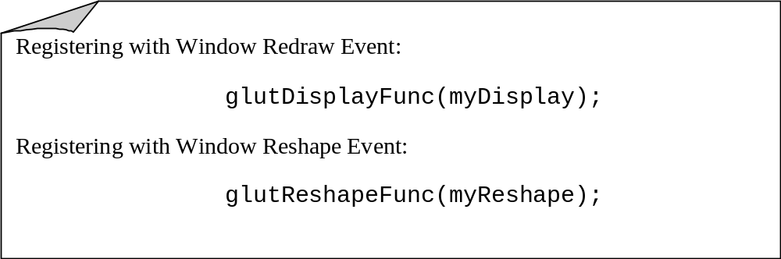
Window Events (OpenGL)

